Slide 1

Geometry
Unit 6, Lesson 10 Similar Figures Volume 1, pg. 348

Slide 2


Benchmark
MA.912.GR.1.6
Solve mathematical and real-world problems involving congruence or similarity in two-dimensional figures.
volume 1, pg. 348

Slide 3
Integrated Mathematical Thinking and Reasoning Standards
MA.K12.MTR.1.1 Actively participate in effortful learning both individually and collectively.
MA.K12.MTR.4.1 Engage in discussions that reflect on the mathematical thinking of self and others.
MA.K12.MTR.5.1 Use patterns and structure to help understand and connect mathematical concepts.
MA.K12.MTR.6.1 Assess the reasonableness of solutions.
volume 1, pg. 348

Slide 4

Learning Target
I can solve mathematical problems using corresponding angles and sides of similar figures.
volume 1, pg. 348

Slide 5

Warm-Up
volume 1, pg. 349

Slide 6
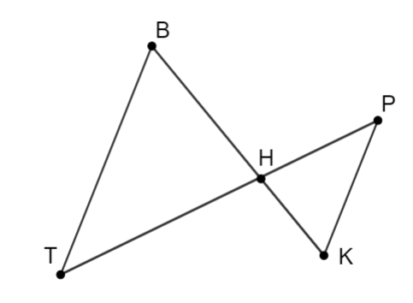
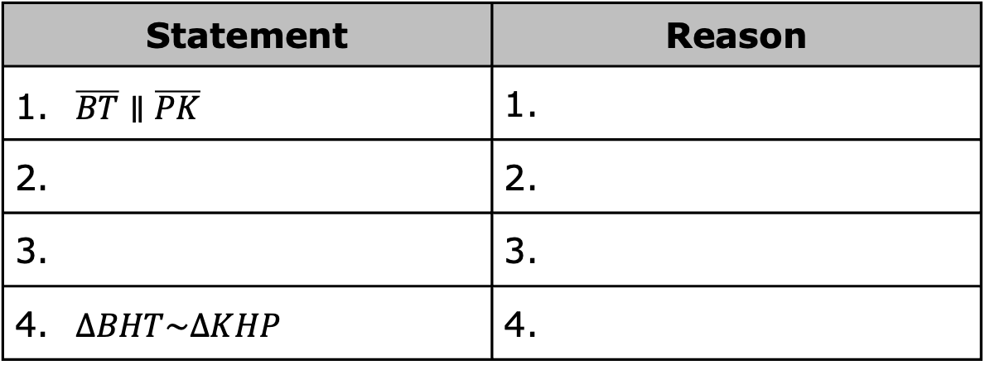
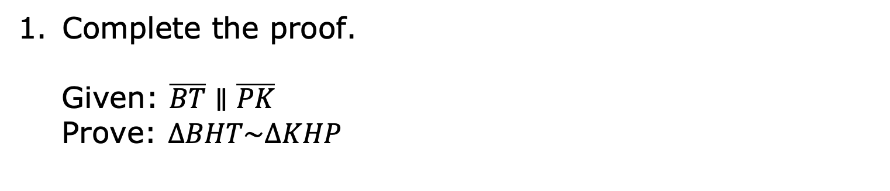
6.10.1 Warm-Up: Bell Work
Complete the proof.
Given: $\overline{BT}∥\overline{PK}$
Prove: $∆BHT\sim ∆KHP$
Statement | Reason
$\overline{BT}∥\overline{PK}$ | 1.
2. | 2.
3. | 3.
$∆BHT\sim ∆KHP$ | 4.
volume 1, pg. 349

Slide 7

Collaboration
volume 1, pg. 349

Slide 8

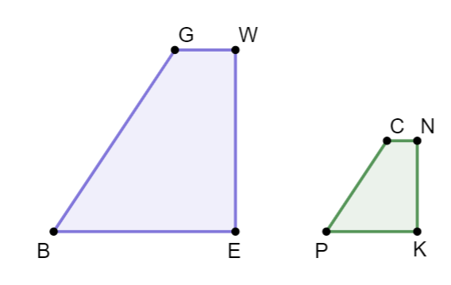
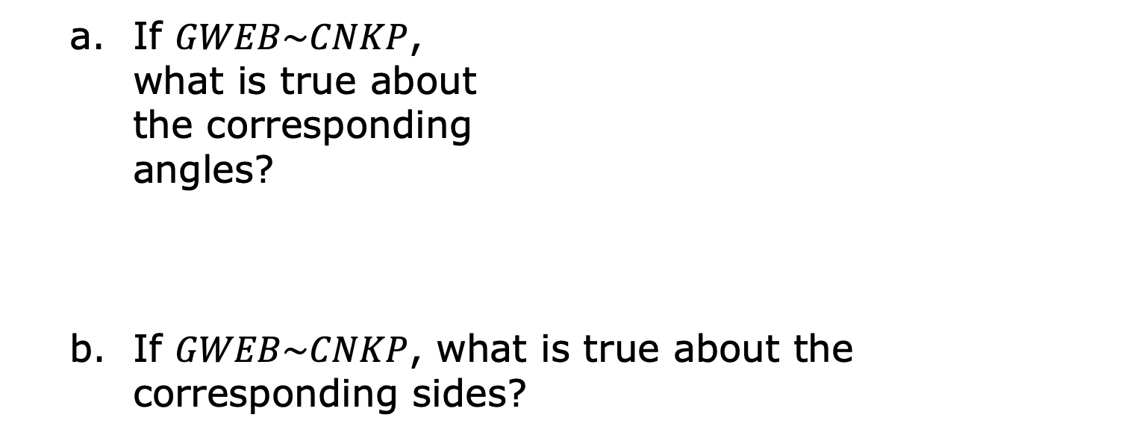
6.10.2 Collaboration: Similar Figures
With your partner, answer the following questions.
𝐺𝑊𝐸𝐵 and 𝐶𝑁𝐾𝑃 are shown.
If $GWEB\sim CNKP$, what is true about the corresponding angles?
If $GWEB\sim CNKP$, what is true about the corresponding sides?
volume 1, pg. 349

Slide 9
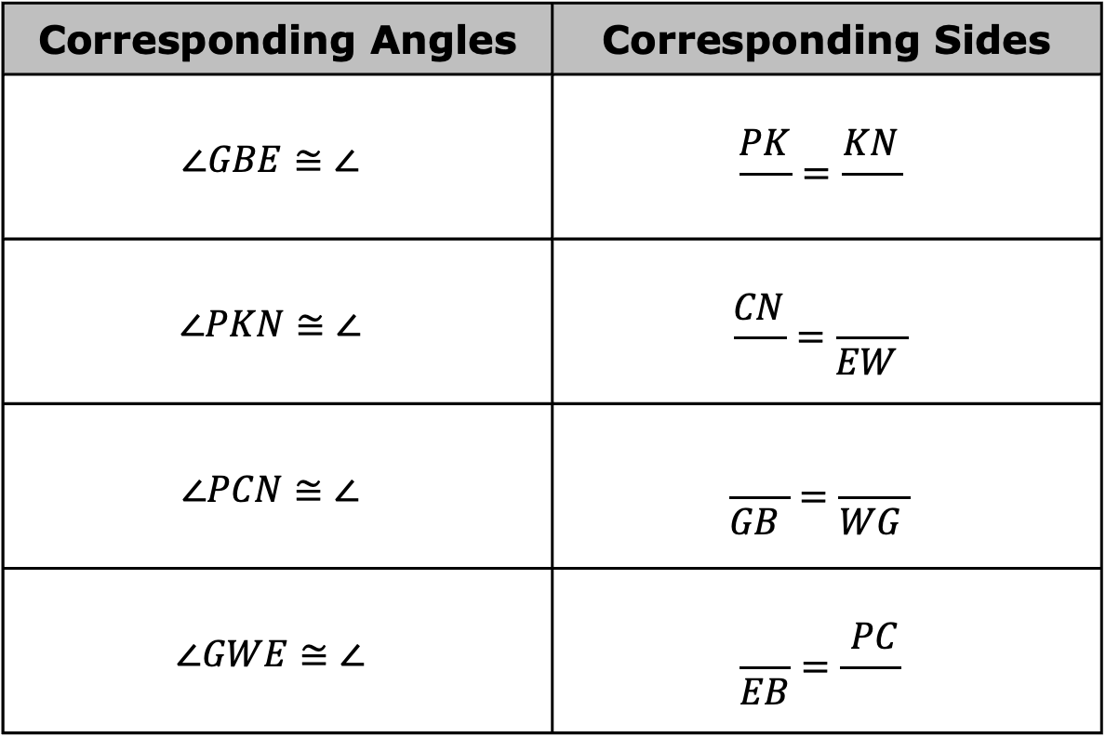
Fill in the table given that $GWEB\sim CNKP$.
Corresponding Angles | Corresponding Sides
$$∠GBE≅∠$$ | $$\frac{PK}{ }=\frac{KN}{ }$$
$$∠PKN≅∠$$ | $$\frac{CN}{ }=\frac{ }{EW }$$
$$∠PCN≅∠$$ | $$\frac{ }{GB }=\frac{ }{WG }$$
$$∠GWE≅∠$$ | $$\frac{ }{EB}=\frac{ PC}{ }$$
volume 1, pg. 349

Slide 10
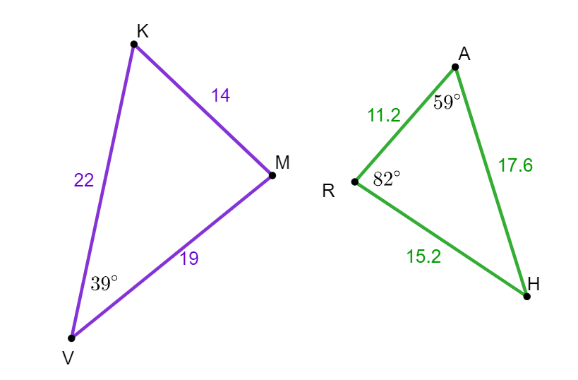

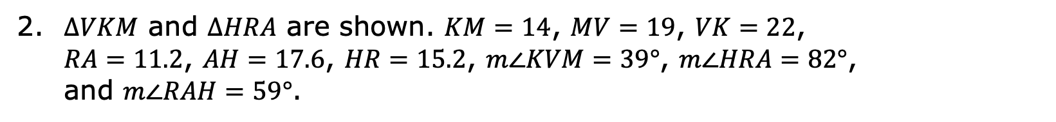
$ΔVKM$ and $ΔHRA$ are shown. $KM=14$, $MV=19$, $VK=22$, $RA=11.2$, $AH=17.6$, $HR=15.2$, $m∠KVM=39°$, $m∠HRA=82°$, and $m∠RAH=59°$.
Using the given information, what can you conclude about $ΔVKM$ and $ΔHRA$?
What similarity theorem or postulate could be used to prove the triangles are similar?
Write a similarity statement for $ΔVKM$ and $ΔHRA$.
volume 1, pg. 350

Slide 11
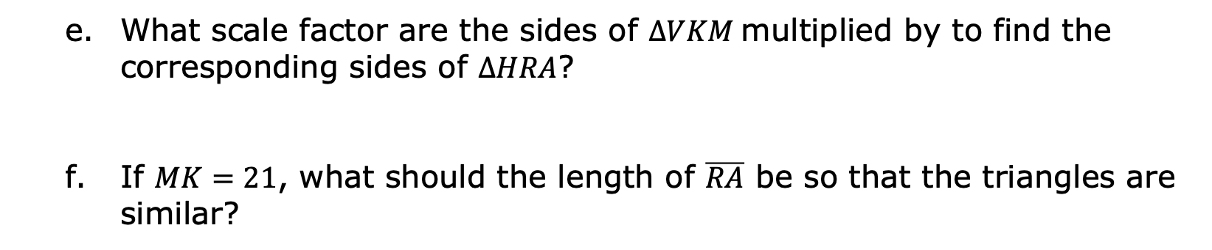
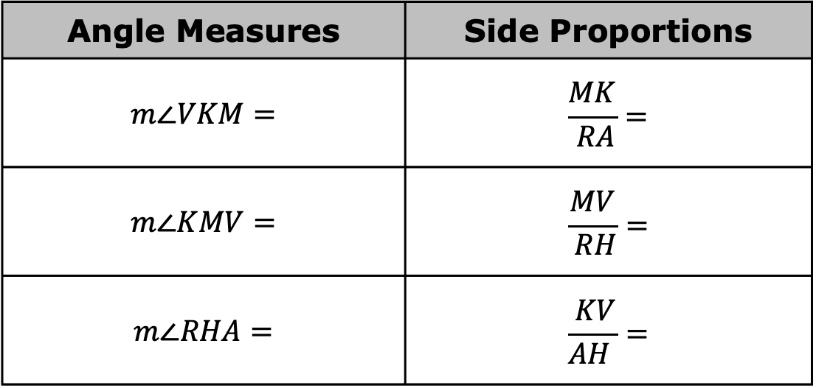
Complete the table.
Angle Measures | Side Proportions
$$m∠VKM=$$ | $$\frac{MK}{ RA}=$$
$$m∠KMV=$$ | $$\frac{MV}{ RH}=$$
$$m∠RHA=$$ | $$\frac{ KV}{AH }=$$
What scale factor are the sides of $∆VKM$multiplied by to find the corresponding sides of $∆HRA$?
If $MK=21$, what should the length of $\overline{RA}$ be so that the triangles are similar?
volume 1, pg. 350

Slide 12
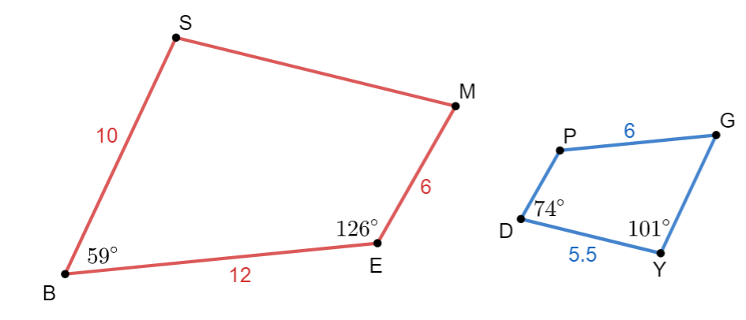
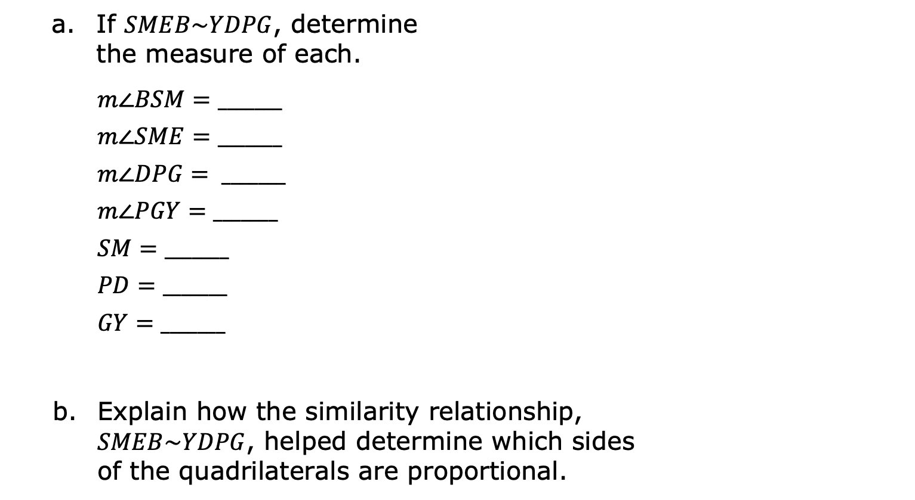
𝑆𝑀𝐸𝐵 and 𝑌𝐷𝑃𝐺 are shown. $SB=10$, $BE=12$, $EM=6$, $DY=5.5$, $PG=6$, $m∠SBE=59°$, $m∠BEM=126°$, $m∠PDY=74°$, and $m∠DYG=101°$.
If $SMEB\sim YDPG$, determine the measure of each.
$$m∠BSM=_______$$
$m∠SME=_______$
$$m∠DPG= _______$$
$m∠PGY=_______$
$$SM=_______$$
$$PD=_______$$
$$GY=_______$$
Explain how the similarity relationship, $SMEB\sim YDPG$, helped determine which sides of the quadrilaterals are proportional.
volume 1, pg. 351

Slide 13

Your Turn
volume 1, pg. 351

Slide 14
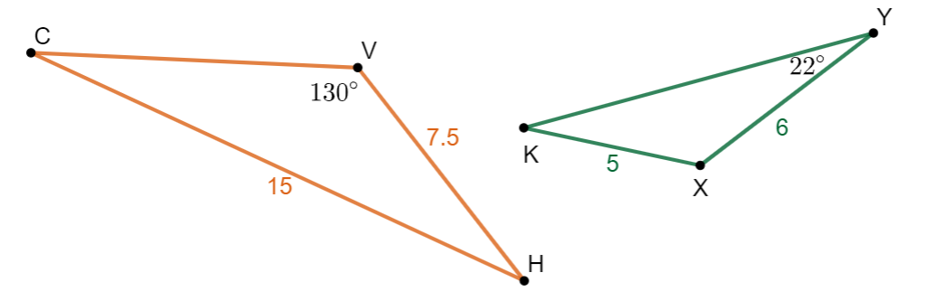
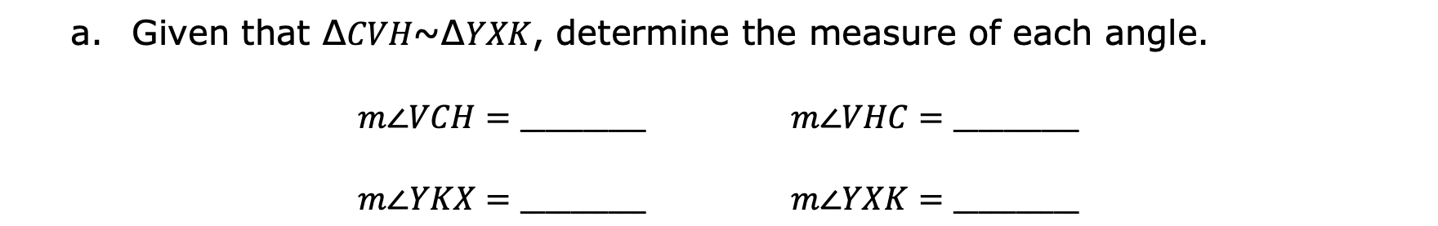
6.10.3 Your Turn!
$ΔCVH$ and $ΔYXK$ are shown where $VH=7.5$, $CH=15$, $KX=5$, $XY=6$, $m∠CVH=130°$, and $m∠XYK=22°$.
Given that ∆𝐶𝑉𝐻~∆𝑌𝑋𝐾, determine the measure of each angle.
$m∠VCH=__________$ $m∠VHC=__________$
$m∠YKX=__________$ $m∠YXK=__________$
volume 1, pg. 351

Slide 15
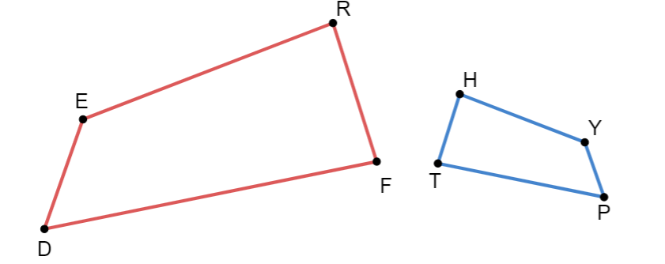
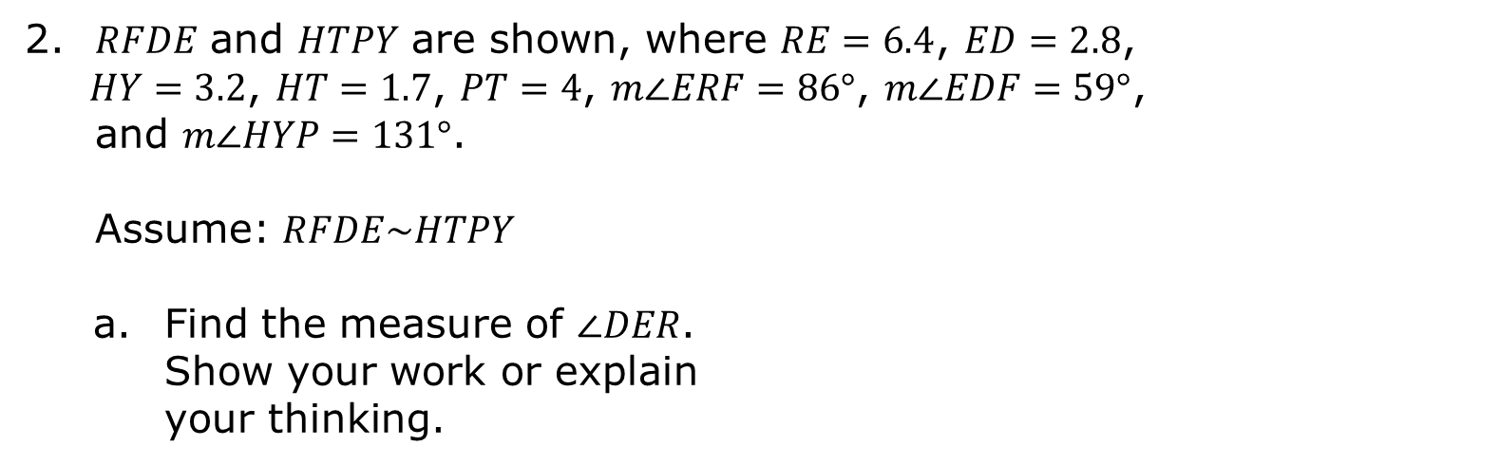
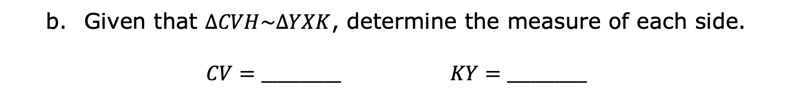
Given that $∆CVH\sim ∆YXK$, determine the measure of each side.
$CV=__________$ $KY=__________$
𝑅𝐹𝐷𝐸 and 𝐻𝑇𝑃𝑌 are shown, where $RE=6.4$, $ED=2.8$, $HY=3.2$, $HT=1.7$, $PT=4$, $m∠ERF=86°$, $m∠EDF=59°$, and $m∠HYP=131°$.
Assume: $RFDE\sim HTPY$
Find the measure of $∠DER$. Show your work or explain your thinking.
volume 1, pg. 351

Slide 16

Determine each measure.
$m∠HTP=__________$ $m∠DFR=__________$
$m∠THY=__________$ $m∠YPT=__________$
What is the ratio of the corresponding sides of 𝑅𝐹𝐷𝐸 to 𝐻𝑇𝑃𝑌?
Determine each measure.
$DF=__________$ $RF=__________$
$$YP=__________$$
volume 1, pg. 352

Slide 17
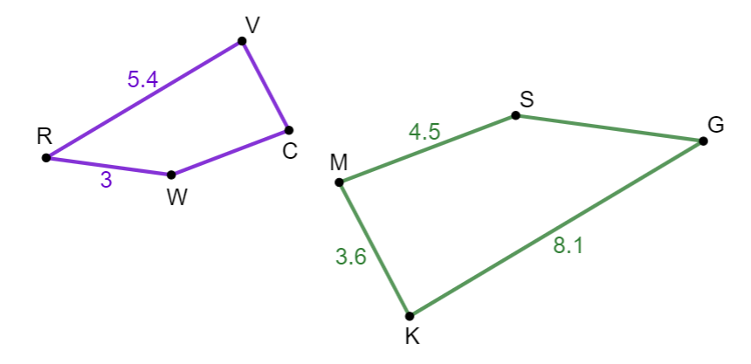
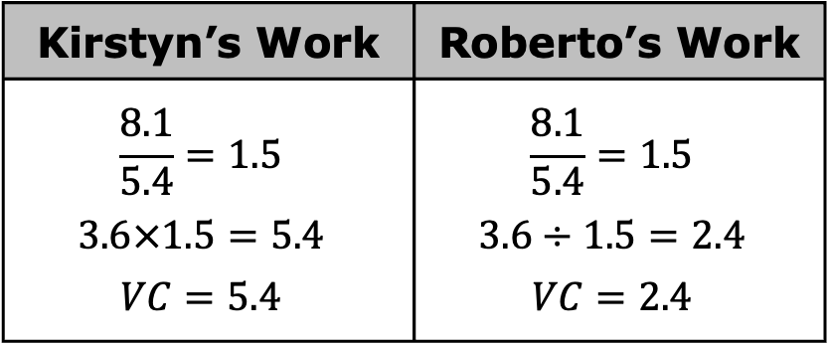
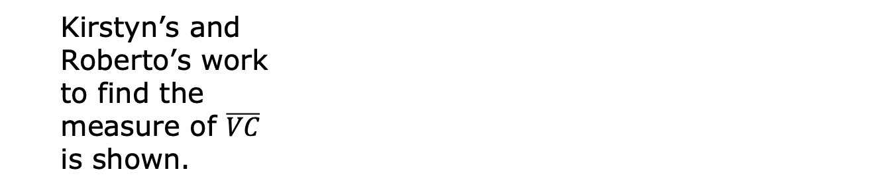
Kirstyn and Roberto were finding the missing side measures for 𝑅𝑉𝐶𝑊 and 𝐺𝐾𝑀𝑆. They were given $RVCW\sim GKMS$, $VR=5.4$, $RW=3$, $SM=4.5$, $MK=3.6$, and $KG=8.1$.
Kirstyn’s and Roberto’s work to find the measure of $\overline{VC}$ is shown.
Kirstyn’s Work | Roberto’s Work
$$\frac{8.1}{5.4}=1.5$$ $$3.6×1.5=5.4$$ $$VC=5.4$$ | $$\frac{8.1}{5.4}=1.5$$ $$3.6÷1.5=2.4$$ $$VC=2.4$$
volume 1, pg. 352

Slide 18

Who do you agree with?
Explain the error in the incorrect work.
Complete the statements.
$CW=__________$ $SG=__________$
volume 1, pg. 352

Slide 19

Wrap-Up
volume 1, pg. 353

Slide 20
6.10.4 Wrap-Up: Reflection
One thing I struggled with today was …
One thing I need to practice more is …
One thing I understand very well is …
volume 1, pg. 353

